Slide 1
What is a fuzzy rule?
A fuzzy rule can be defined as a conditional statement in the form:
IF x is A
THEN y is B
where x and y are linguistic variables; and A and B are linguistic values determined by fuzzy sets on the universe of discourses X and Y, respectively.

Slide 2
Linguistic variables
At the root of fuzzy set theory lies the idea of linguistic variables.
A linguistic variable is a fuzzy variable. For example, the statement “John is tall” implies that the linguistic variable John takes the linguistic value tall.
The range of possible values of a linguistic variable represents the universe of discourse of that variable. For example, the universe of discourse of the linguistic variable speed might have the range between 0 and 220 km/h and may include such fuzzy subsets as very slow, slow, medium, fast, and very fast.

Slide 3
What is the difference between classical and fuzzy rules?
A classical IF-THEN rule uses binary logic, for
Rule: 1
IF speed is > 100
THEN Min_stopping_Dist = 300
Rule: 2
IF speed is < 40
THEN Max_stopping_distance = 40
The variable speed can have any numerical value between 0 and 220 km/h, and stopping_distance can take either value 300 or 40. In other words, classical rules are expressed in the black-and-white language of Boolean logic.

Slide 4
We can also represent the stopping distance rules in a fuzzy form:
Rule: 1
IF speed is fast
THEN stopping_distance is long
Rule: 2
IF speed is slow
THEN stopping_distance is short
In fuzzy rules, the linguistic variable speed also has the range (the universe of discourse) between 0 and 220 km/h, but this range includes fuzzy sets, such as slow, medium and fast. The universe of discourse of the linguistic variable stopping_distance can be between 0 and 300 m and may include such fuzzy sets as short, medium and long.

Slide 5
Hedges are terms that modify the shape of fuzzy sets. They include adverbs such as very, somewhat, quite, more or less and slightly.
IF height is very tall
THEN weight is very heavy
IF speed is very slow
THEN stopping_distance is very short

Slide 6
Fuzzy Rules fire partially
And relate fuzzy sets
Fuzzy rules relate fuzzy sets.
In a fuzzy system, all rules can fire to some extent, or in other words fire partially. If the antecedent is true to some degree of membership, then the consequent is also true to some degree.

Slide 7
A fuzzy rule can have multiple antecedents, for example:
IF project_duration is long
AND project_staffing is large
AND project_funding is inadequate
THEN risk is high
IF service is excellent
OR food is delicious
THEN tip is generous

Slide 8
OR Multiple Consequents
IF temperature is hot
THEN hot_water is reduced;
cold_water is increased

Slide 9
More on Fuzzy inference
The most commonly used fuzzy inference technique is the so-called Mamdani method. In 1975, Professor Ebrahim Mamdani of London University built one of the first fuzzy systems to control a steam engine and boiler combination. He applied a set of fuzzy rules supplied by experienced human operators.

Slide 10
Mamdani fuzzy inference Algorithm
The Mamdani-style fuzzy inference process is performed in four steps:
fuzzification of the input variables,
rule evaluation;
aggregation of the rule outputs, and finally
defuzzification.

Slide 11
We examine a simple two-input one-output problem that includes three rules:
Rule: 1 Rule: 1
IF x is A3 IF project_funding is adequate
OR y is B1 OR project_staffing is small
THEN z is C1 THEN risk is low
Rule: 2 Rule: 2
IF x is A2 IF project_funding is marginal
AND y is B2 AND project_staffing is large
THEN z is C2 THEN risk is normal
Rule: 3
IF x is A1 IF project_funding is inadequate
THEN z is C3 THEN risk is high

Slide 12
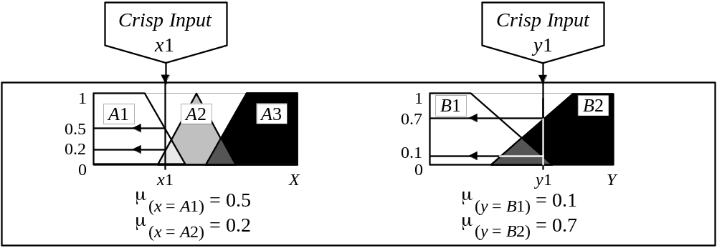
Step 1: Fuzzification
The first step is to take the crisp inputs, x1 and y1 (project funding and project staffing), and determine the degree to which these inputs belong to each of the appropriate fuzzy sets.

Slide 13
Step 2: Rule Evaluation
The second step is to take the fuzzified inputs, μ_{(x=A1)} = 0.5, μ_{(x=A2)} = 0.2, μ_{(y=B1)} = 0.1 and μ_{(y=B2)} = 0.7, and apply them to the antecedents of the fuzzy rules. If a given fuzzy rule has multiple antecedents, the fuzzy operator (AND or OR) is used to obtain a single number that represents the result of the antecedent evaluation. This number (the truth value) is then applied to the consequent membership function.

Slide 14
To evaluate the disjunction of the rule antecedents, we use the OR fuzzy operation. Typically, fuzzy expert systems make use of the classical fuzzy operation union:
    μ_{A}∪_{B}(x) = max [μ_{A}(x), μ_{B}(x)]
Similarly, in order to evaluate the conjunction of the rule antecedents, we apply the AND fuzzy operation intersection:
    μ_{A}∩_{B}(x) = min [μ_{A}(x), μ_{B}(x)]

Slide 15
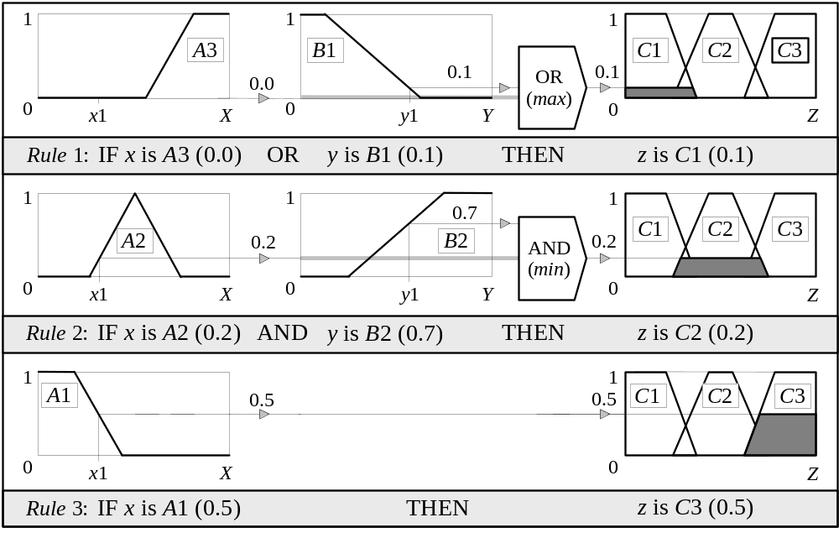
Mamdani-style rule evaluation

Slide 16
Now the result of the antecedent evaluation can be applied to the membership function of the consequent.
The most common method of correlating the rule consequent with the truth value of the rule antecedent is to cut the consequent membership function at the level of the antecedent truth. This method is called clipping. Since the top of the membership function is sliced, the clipped fuzzy set loses some information. However, clipping is still often preferred because it involves less complex and faster mathematics, and generates an aggregated output surface that is easier to defuzzify.

Slide 17
While clipping is a frequently used method, scaling offers a better approach for preserving the original shape of the fuzzy set. The original membership function of the rule consequent is adjusted by multiplying all its membership degrees by the truth value of the rule antecedent. This method, which generally loses less information, can be very useful in fuzzy expert systems.

Slide 18
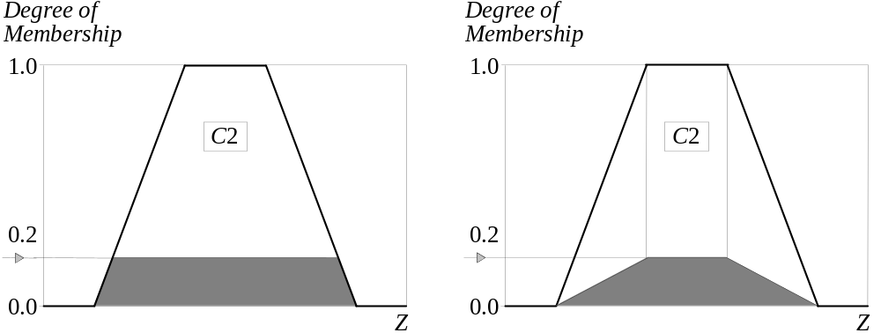
Clipped and scaled membership functions

Slide 19
Step 3: Aggregation of the rule outputs
Aggregation is the process of unification of the outputs of all rules. We take the membership functions of all rule consequents previously clipped or scaled and combine them into a single fuzzy set.
The input of the aggregation process is the list of clipped or scaled consequent membership functions, and the output is one fuzzy set for each output variable.

Slide 20
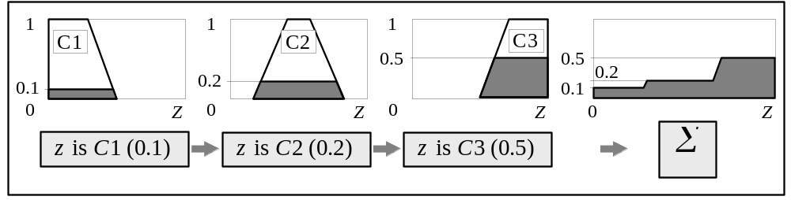
Aggregation of the rule outputs

Slide 21
Step 4: Defuzzification
The last step in the fuzzy inference process is defuzzification. Fuzziness helps us to evaluate the rules, but the final output of a fuzzy system has to be a crisp number. The input for the defuzzification process is the aggregate output fuzzy set and the output is a single number.

Slide 22
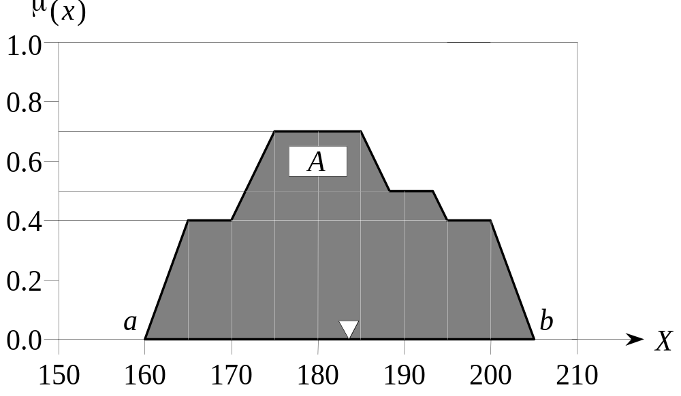
There are several defuzzification methods, but probably the most popular one is the centroid technique. It finds the point where a vertical line would slice the aggregate set into two equal masses.

Slide 23
Centroid defuzzification method finds a point representing the centre of gravity of the fuzzy set, A, on the interval, ab.
A reasonable estimate can be obtained by calculating it over a sample of points.

Slide 24
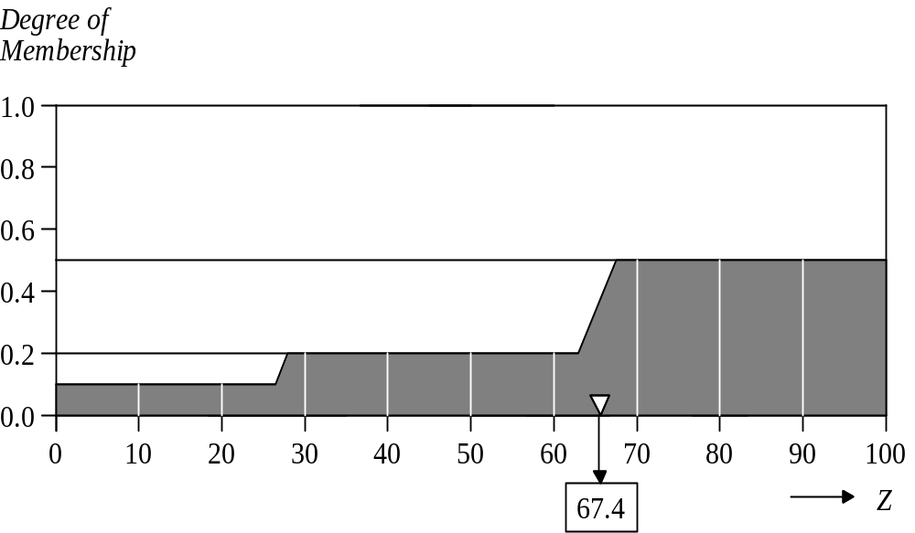
Centre of gravity (COG):

Slide 25
Process of developing a fuzzy expert system
1. Specify the problem and define linguistic variables.
2. Determine fuzzy sets.
3. Elicit and construct fuzzy rules.
4. Encode the fuzzy sets, fuzzy rules and procedures
to perform fuzzy inference into the expert system.
5. Evaluate and tune the system.

Slide 26
Sugeno fuzzy inference
Mamdani-style inference, as we have just seen, requires us to find the centroid of a two-dimensional shape by integrating across a continuously varying function. In general, this process is not computationally efficient.
Michio Sugeno suggested to use a single spike, a singleton, as the membership function of the rule consequent. A singleton, or more precisely a fuzzy singleton, is a fuzzy set with a membership function that is unity at a single particular point on the universe of discourse and zero everywhere else.

Slide 27
Sugeno-style fuzzy inference is very similar to the Mamdani method. Sugeno changed only a rule consequent. Instead of a fuzzy set, he used a mathematical function of the input variable. The format of the Sugeno-style fuzzy rule is
IF x is A
AND y is B
THEN z is f (x, y)
where x, y and z are linguistic variables; A and B are fuzzy sets on universe of discourses X and Y, respectively; and f (x, y) is a mathematical function.

Slide 28
The most commonly used zero-order Sugeno fuzzy model applies fuzzy rules in the following form:
IF x is A
AND y is B
THEN z is k
where k is a constant.
In this case, the output of each fuzzy rule is constant. All consequent membership functions are represented by singleton spikes.

Slide 29
We examine a simple two-input one-output problem that includes three rules:
Rule: 1 Rule: 1
IF x is A3 IF project_funding is adequate
OR y is B1 OR project_staffing is small
THEN z is C1 THEN risk is low
Rule: 2 Rule: 2
IF x is A2 IF project_funding is marginal
AND y is B2 AND project_staffing is large
THEN z is C2 THEN risk is normal
Rule: 3 Rule: 3
IF x is A1 IF project_funding is inadequate
THEN z is C3 THEN risk is high

Slide 30
Mamdani-style rule evaluation

Slide 31
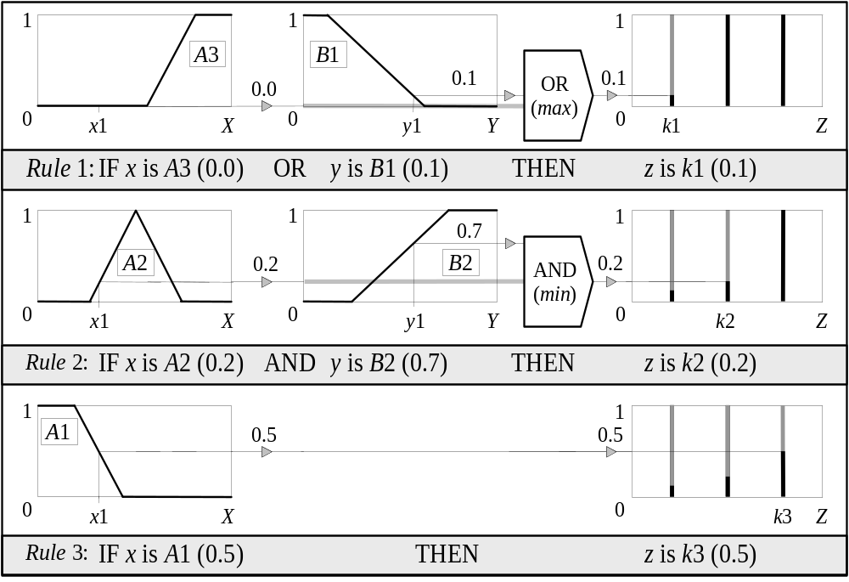
Sugeno-style rule evaluation

Slide 32
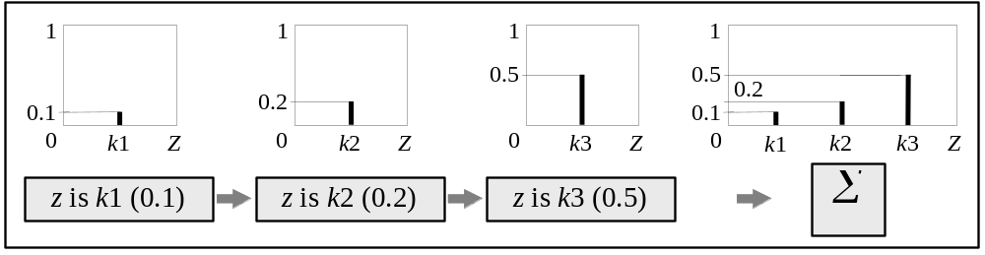
Sugeno-style aggregation of the rule outputs

Slide 33
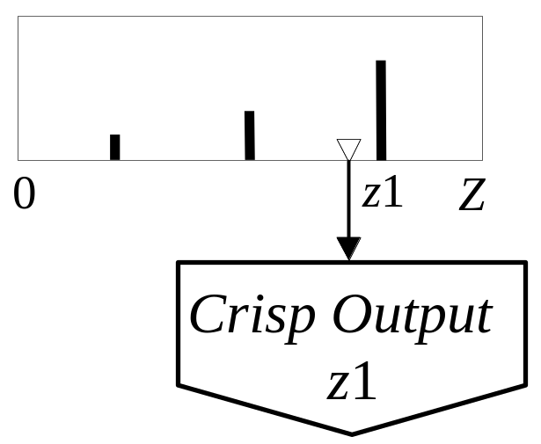
Weighted average (WA):
Sugeno-style defuzzification

Slide 34
How to make a decision on which method to apply − Mamdani or Sugeno?
Mamdani method is widely accepted for capturing expert knowledge. It allows us to describe the expertise in more intuitive, more human-like manner. However, Mamdani-type fuzzy inference entails a substantial computational burden.
On the other hand, Sugeno method is computationally effective and works well with optimisation and adaptive techniques, which makes it very attractive in control problems, particularly for dynamic nonlinear systems.

Slide 35
Building a fuzzy expert system: case study
A service centre keeps spare parts and repairs parts.
A customer brings a failed item and receives a spare of the same type.
Failed parts are repaired by servers, placed on the shelf, and thus become spares.
The objective here is to advise a manager of the service centre on certain decision policies to keep the customers satisfied.
Advise on the initial number of spares to keep delay reasonable

Slide 36
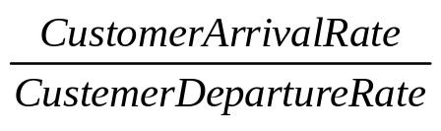
Step 1: Specify the problem and define
linguistic variables
There are four main linguistic variables: average waiting time (mean delay) m, repair utilisation factor of the service centre ρ, number of servers s, and initial number of spare parts n.
ρ =
The system must advise management on the number of spares
to keep as well as the number of servers. Increasing either
will increase cost and decrease waiting time in some proportion.

Slide 37
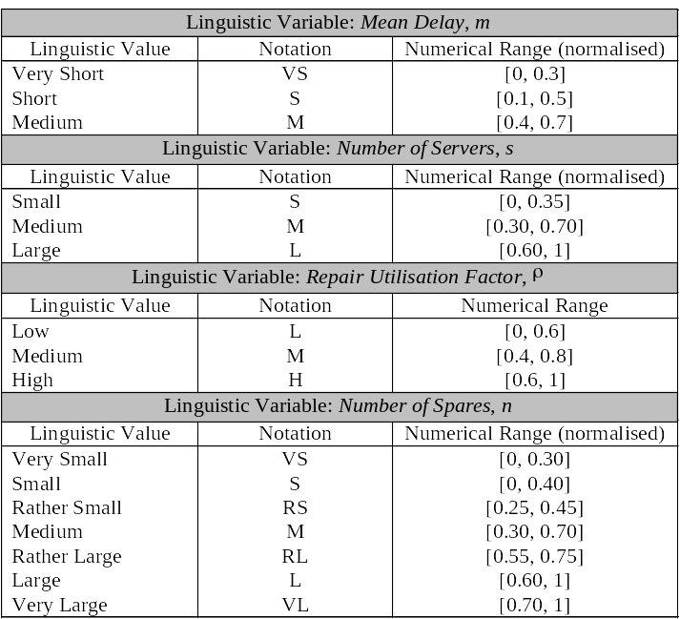
Linguistic variables and their ranges

Slide 38
Step 2: Determine fuzzy sets
Fuzzy sets can have a variety of shapes. However, a triangle or a trapezoid can often provide an adequate representation of the expert knowledge, and at the same time, significantly simplifies the process of computation.

Slide 39
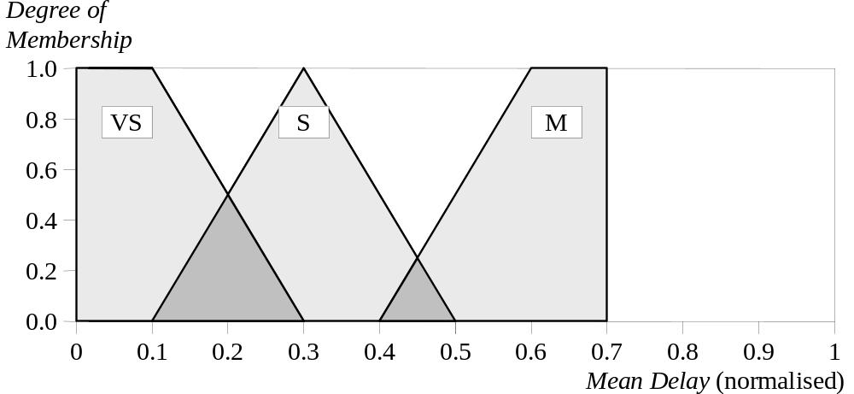
Fuzzy sets of Mean Delay m

Slide 40
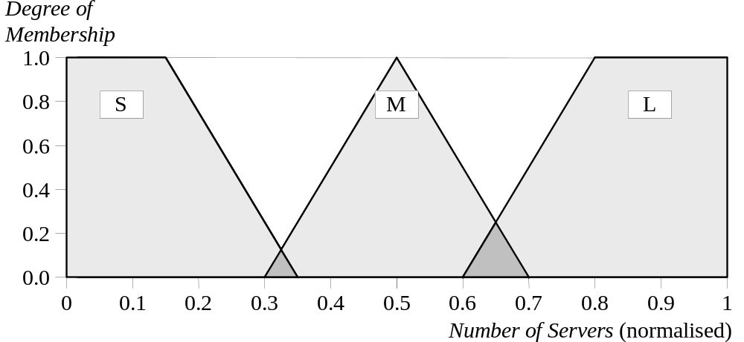
Fuzzy sets of Number of Servers s

Slide 41
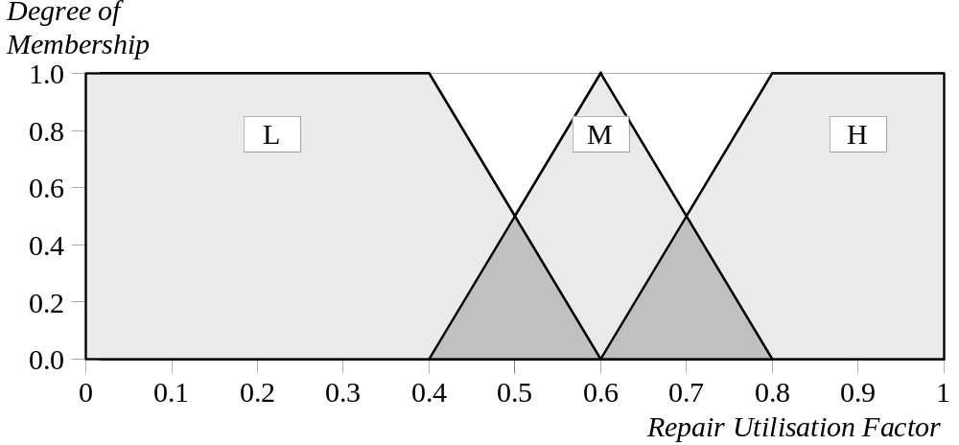
Fuzzy sets of Repair Utilisation Factor ρ

Slide 42
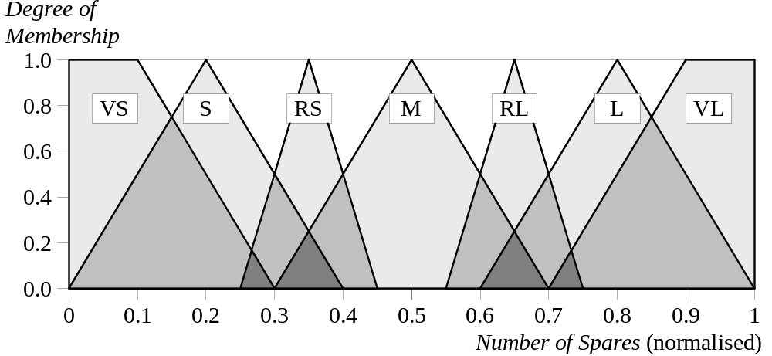
Fuzzy sets of Number of Spares n

Slide 43
Step 3: Elicit and construct fuzzy rules
To accomplish this task, we might ask the expert to describe how the problem can be solved using the fuzzy linguistic variables defined previously.
Required knowledge also can be collected from other sources such as books, computer databases, flow diagrams and observed human behaviour.

Slide 44
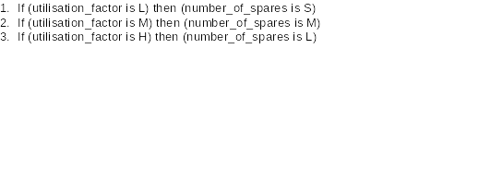
Rules about utilization and spares

Slide 45
Rules about delay, servers and spares
If (mean_delay is VS) and (number_of_servers is S) then (number_of_spares is VL)
If (mean_delay is S) and (number_of_servers is S) then (number_of_spares is L)
6. If (mean_delay is M) and (number_of_servers is S) then (number_of_spares is M)
7. If (mean_delay is VS) and (number_of_servers is M) then (number_of_spares is RL)
8. If (mean_delay is S) and (number_of_servers is M) then (number_of_spares is RS)
9. If (mean_delay is M) and (number_of_servers is M) then (number_of_spares is S)
10. If (mean_delay is VS) and (number_of_servers is L) then (number_of_spares is M)
11. If (mean_delay is S) and (number_of_servers is L) then (number_of_spares is S)
12. If (mean_delay is M) and (number_of_servers is L) then (number_of_spares is VS)

Slide 46
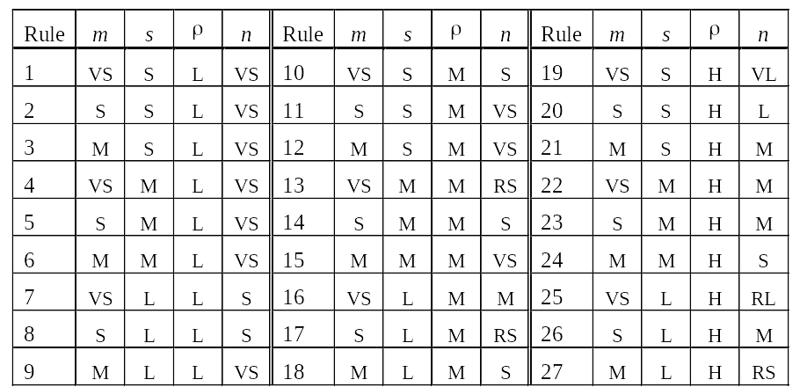
The larger rule base for three combinations
if mean_delay is VS
and number_servers is S
and utilization is Low
then spares is VS

Slide 47
Step 4: Encode the fuzzy sets, fuzzy rules
and procedures to perform fuzzy
inference into the expert system

Slide 48
Step 5: Evaluate and tune the system
The last, and the most laborious, task is to evaluate and tune the system. We want to see whether our fuzzy system meets the requirements specified at the beginning.
Several test situations depend on the mean delay, number of servers and repair utilisation factor.
The Fuzzy Logic Toolbox can generate surface to help us analyse the system’s performance.

Slide 49
However, the expert might not be satisfied with the system performance.
To improve the system performance, we may use additional sets − Rather Small and Rather Large − on the universe of discourse Number of Servers, and then extend the rule base.

Slide 50
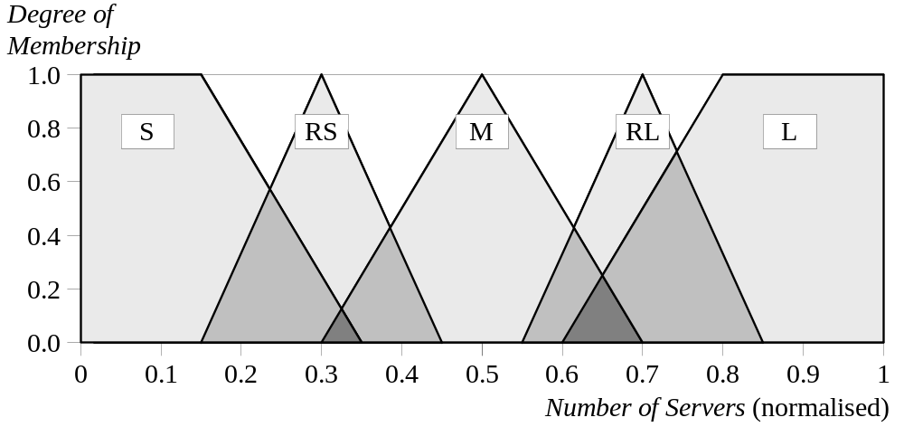
Modified fuzzy sets of Number of Servers s

Slide 51
Tuning fuzzy systems
1. Review model input and output variables, and if required redefine their ranges.
2. Review the fuzzy sets, and if required define
additional sets on the universe of discourse.
The use of wide fuzzy sets may cause the fuzzy
system to perform roughly.
3. Provide sufficient overlap between neighbouring sets. It is suggested that triangle-to-triangle and trapezoid-to-triangle fuzzy sets should overlap between 25% to 50% of their bases.

Slide 52
4. Review the existing rules, and if required add new rules to the rule base.
5. Adjust the rule execution weights. Most fuzzy
logic tools allow control of the importance of rules
by changing a weight multiplier.
6. Revise shapes of the fuzzy sets. In most cases,
fuzzy systems are highly tolerant of a shape
approximation.

